Slide 1
Relational Database Design
Rushali Patil

Slide 2
Features of Good Relational Database Design
Minimum information redundancy
No Anomalies:
Insert
Delete
Update

Slide 3
Minimum Information Redundancy
Students Record
RollNo | PRN | Name | Branch ID | Branch Name | Email-ID
3301 | CS12367 | Ram | COMP | Computer Engg | ram@aitpune.edu.in
3312 | XY45689 | Sham | COMP | Computer Engg | sham@aitpune.edu.in
3411 | MN37934 | Ram | COMP | Computer Engg | ram12@aitpune.edu.in
3411 | AD28646 | Sita | E&TC | Electornics& Telecommunication | sita@aitpune.edu.in
3210 | CZ39410 | Ram | IT | Information Technology | ram1999@aitpune.edu.in

Slide 4
Insert Anomaly
An insert anomaly occurs when certain attributes cannot be inserted into the databases without the presence of other attributes
Students Record
E.g. New student with Name Roshan is admitted to college but no branch is allocated so can't be added
RollNo | PRN | Name | Branch ID | Branch Name | Email-ID
3301 | CS12367 | Ram | COMP | Computer Engg | ram@aitpune.edu.in
3312 | XY45689 | Sham | COMP | Computer Engg | sham@aitpune.edu.in
3411 | MN37934 | Ram | COMP | Computer Engg | ram12@aitpune.edu.in
3411 | AD28646 | Sita | E&TC | Electornics& Telecommunication | sita@aitpune.edu.in

Slide 5
Update Anomaly
An update anomaly exists when one or more instances of duplicated data is updated but not all
Students Record
If we update COMP branch ID to CSE only for first 2 rows
RollNo | PRN | Name | Branch ID | Branch Name | Email-ID
3301 | CS12367 | Ram | COMP | Computer Engg | ram@aitpune.edu.in
3312 | XY45689 | Sham | COMP | Computer Engg | sham@aitpune.edu.in
3411 | MN37934 | Ram | COMP | Computer Engg | ram12@aitpune.edu.in
3411 | AD28646 | Sita | E&TC | Electornics& Telecommunication | sita@aitpune.edu.in

Slide 6
Normalization
Database normalization is the process of structuring a relational database in accordance with a series of normal forms in order to reduce data redundancy and improve data integrity
It was first proposed by Edgar F. Codd as part of his relational model
Any attributive data or indirectly related data are put in different tables and these tables are connected with a logical relationship between parent and child tables

Slide 7
Normalization
Advantages
Normalization increases data consistency as it avoids the duplicity of data by storing the data in one place only
Normalization helps in grouping like or related data under the same schema, thereby resulting in the better grouping of data
Normalization improves searching faster as indexes can be created faster
Disadvantages
We cannot find the associated data for, say a product or employee in one place and we have to join more than one table. This causes a delay in retrieving the data

Slide 8
First Normal Form
Domain is atomic if its elements are considered to be indivisible units
Examples of non-atomic domains:
Set of names, composite attributes
Multivalued attributes
A relational schema R is in first normal form if the domains of all attributes of R are atomic
Non-atomic values complicate storage and encourage redundant (repeated) storage of data
Example: Set of accounts stored with each customer, and set of owners stored with each account

Slide 9
First Normal Form
RollNo | PRN | Name | Branch ID | Phone No | Email-ID
3301 | CS12367 | Ram | COMP | 1234567899 2345677887 | ram@aitpune.edu.in
3312 | XY45689 | Sham | COMP | 3344556677 | sham@aitpune.edu.in
3411 | MN37934 | Ram | COMP | 267788993 123456786 | ram12@aitpune.edu.in
3411 | AD28646 | Sita | E&TC | 444455555 | sita@aitpune.edu.in
RollNo | PRN | Name | Branch ID | Phone No | Email-ID
3301 | CS12367 | Ram | COMP | 1234567899 | ram@aitpune.edu.in
3301 | CS12367 | Ram | COMP | 2345677887 | ram@aitpune.edu.in
3312 | XY45689 | Sham | COMP | 3344556677 | sham@aitpune.edu.in
3411 | MN37934 | Ram | COMP | 267788993 | ram12@aitpune.edu.in
3411 | MN37934 | Ram | COMP | 123456786 | ram12@aitpune.edu.in
3411 | AD28646 | Sita | E&TC | 444455555 | sita@aitpune.edu.in

Slide 10
Student(RollNo, PRN ,Name,Branch ID,Phone No , Email-ID)
Student(RollNo, PRN ,Name,Branch ID, Email-ID)
Stud_Contact(RollNo, Phone No)

Slide 11
Functional Dependency
Functional Dependency is a constraint between two sets of attributes in a relation from a database. In other words, a functional dependency is a constraint between two keys. Given a relation R, a set of attributes X in R is said to functionally determine another set of attributes Y, also in R, (written X → Y) if, and only if, each X value in R is associated with precisely one Y value in R; R is then said to satisfy the functional dependency X → Y
It determines the relation of one attribute to another attribute in a database management system (DBMS) system
It helps you to maintain the quality of data in the database
A functional dependency is denoted by an arrow →
The functional dependency of X on Y is represented by X → Y.
Note: Functional Dependency plays a vital role to find the difference between good and bad database design

Slide 12
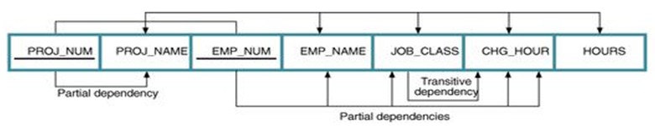
Dependency Diagram
Dependency Diagram
The primary key components are bold, underlined, and shaded in a different color.
The arrows above entities indicate all desirable dependencies, i.e., dependencies that are based on PK.
The arrows below the dependency diagram indicate less desirable dependencies -- partial dependencies and transitive dependencies.

Slide 13
Second Normal Form (2 NF)
A table is in 2NF if:
It is in 1NF and
It includes no partial dependencies; that is, no attribute is dependent on only a portion of the primary key.
(It is still possible for a table in 2NF to exhibit transitive dependency; that is, one or more attributes may be functionally dependent on nonkey attributes.)

Slide 14
Partial Dependency
If a Non prime or Non key attribute of the relation is dependent on only a part of the candidate key then such dependency is defined as partial dependency
X->Y (X: Determinant Y: Dependent)
X is subset of Candidate Key
Y is Non Prime or Non Key Attribute
Note:
While identifying the partial dependencies make sure that dependent is non prime/non key and determinant is part of candidate key
In order to have any partial dependencies, the relation should have at least one of the candidate key as composite
Partial dependencies will cause redundancies, hence they should get eliminated

Slide 15
Converting to 2NF
Conversion to Second Normal Form
Starting with the 1NF format, the database can be converted into the 2NF format by
Writing each key component on a separate line, and then writing the original key on the last line and
Writing the dependent attributes after each new key.
PROJECT (PROJ_NUM, PROJ_NAME)
EMPLOYEE (EMP_NUM, EMP_NAME, JOB_CLASS, CHG_HOUR)
ASSIGN (PROJ_NUM, EMP_NUM, HOURS)

Slide 16
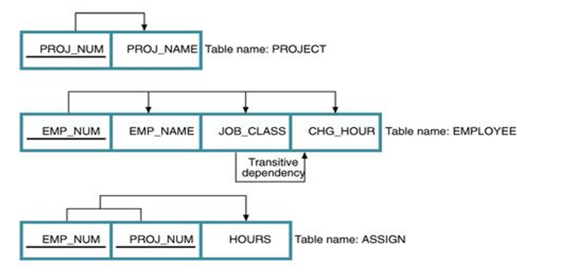
Dependency Diagram

Slide 17
Third Normal Form (3 NF)
3NF Definition
A table is in 3NF if:
It is in 2NF and
It contains no transitive dependencies.

Slide 18
Transitive Dependency
Let A, B, and C designate three distinct (but not necessarily disjoint) sets of attributes of a relation. Suppose all three of the following conditions hold:
A → B
It is not the case that B → A
B → C
Then the functional dependency A → C (which follows from 1 and 3 by the axiom of transitivity) is a transitive dependency
Note:
While identifying the partial dependencies make sure that dependent is non prime/non key and determinant is part of candidate key
In order to have any partial dependencies, the relation should have at least one of the candidate key as composite
Partial dependencies will cause redundancies, hence they should get eliminated.

Slide 19
Convertion To Third Normal Form (3 NF)
Conversion to Third Normal Form
Create a separate table with attributes in a transitive functional dependence relationship.
PROJECT (PROJ_NUM, PROJ_NAME)
ASSIGN (PROJ_NUM, EMP_NUM, HOURS)
EMPLOYEE (EMP_NUM, EMP_NAME, JOB_CLASS)
JOB (JOB_CLASS, CHG_HOUR)

Slide 20
Example 1
Student(IDSt, StudentName, IDProf, ProfessorName, Grade)
Functional Dependencies:
IDProf --> ProfessorName
IDSt --> StudentName
IDSt, IDProf --> Grade
Students(IDSt,StudentName)
Professors(IDProf , ProfessorName)
Grades(IDSt, IDProf , Grade)

Slide 21
Example 2
Vendor(ID, Name, Account_No, Bank_Code_No, Bank)
Functional Dependencies:
ID --> Name, Account_No, Bank_Code_No
Bank_Code_No --> Bank
Vendor(ID, Name, Account_No, Bank_Code_No)
Bank(Bank_Code_No , Bank)

Slide 22
Example 3
Invoice(Order_ID, Order_Date, Customer_ID, Customer_Name, Customer_Address, Product_ID, Product_Description, Product_Finish, Unit_Price, Order_Quantity)
Functional Dependencies:
Order_ID ->Order_Date, Customer_ID, Customer_Name, Customer_Address
Customer_ID -> Customer_Name, Customer_Address
Product_ID -> Product_Description, Product_Finish, Unit_Price
Order_ID, Product_ID -> Order_Quantity

Slide 23
2NF
CustomerOrder(Order_ID , Order_Date, Customer_ID, Customer_Name, Customer_Address )
Product(Product_ID , Product_Description, Product_Finish, Unit_Price)
OrderLine(Order_ID, Product_ID , Order_Quantity)
Functional Dependency:
Customer_ID -> Customer_Name, Customer_Address
Hence not in 3NF

Slide 24
3NF
CustomerOrder(Order_ID , Order_Date, Customer_ID, Customer_Name, Customer_Address )
Product(Product_ID , Product_Description, Product_Finish, Unit_Price)
OrderLine(Order_ID, Product_ID ,Order_Quantity)
Final Solution:
Order(Order_ID , Order_Date, Customer_ID)
Customer(Customer_ID , Customer_Name, Customer_Address)
Product(Product_ID , Product_Description, Product_Finish, Unit_Price)
OrderLine(Order_ID, Product_ID ,Order_Quantity)

